Slide 1
Community Service Visit: Feeding Stray Animals
Presented by: Saahil Ghulam Mohammad (24K-0570) & Hamza Shahid (24K-0869)
BCS-2D
Civics and Community Engagement

Slide 2
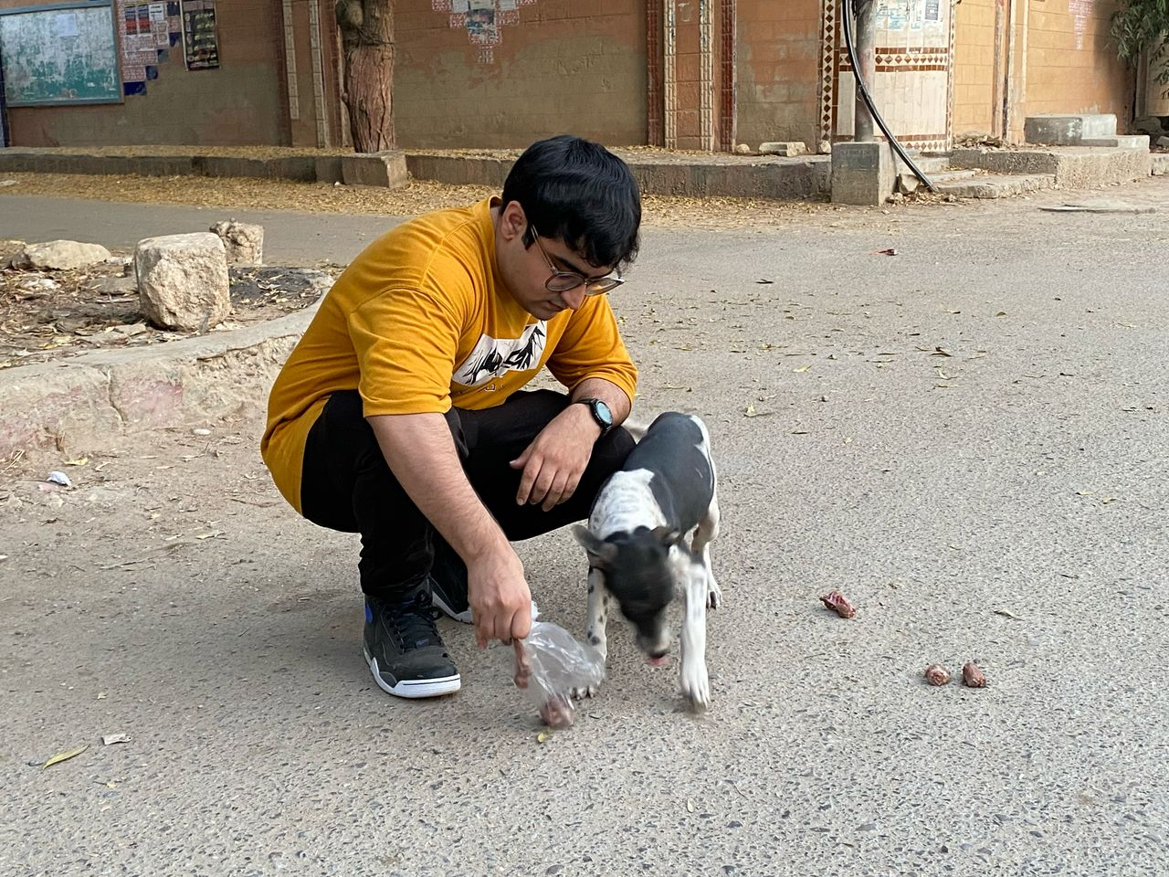
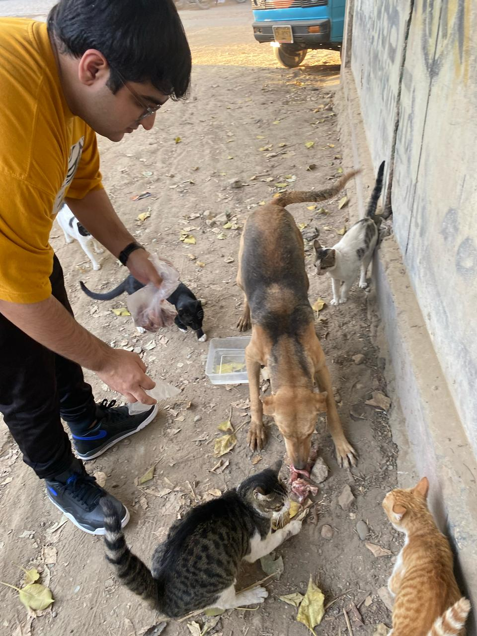
Introduction
Our community service visit aimed to provide food and care to stray animals.
Objectives:
- Provide food and water to stray animals.
- Educate the community on animal welfare.
- Promote empathy towards animals.

Slide 3
SDGs Addressed
- SDG 3: Good Health & Well-being
- Ensuring proper nutrition for stray animals to prevent disease spread.
- SDG 15: Life on Land
- Promoting the protection and well-being of animals for a balanced ecosystem.

Slide 4
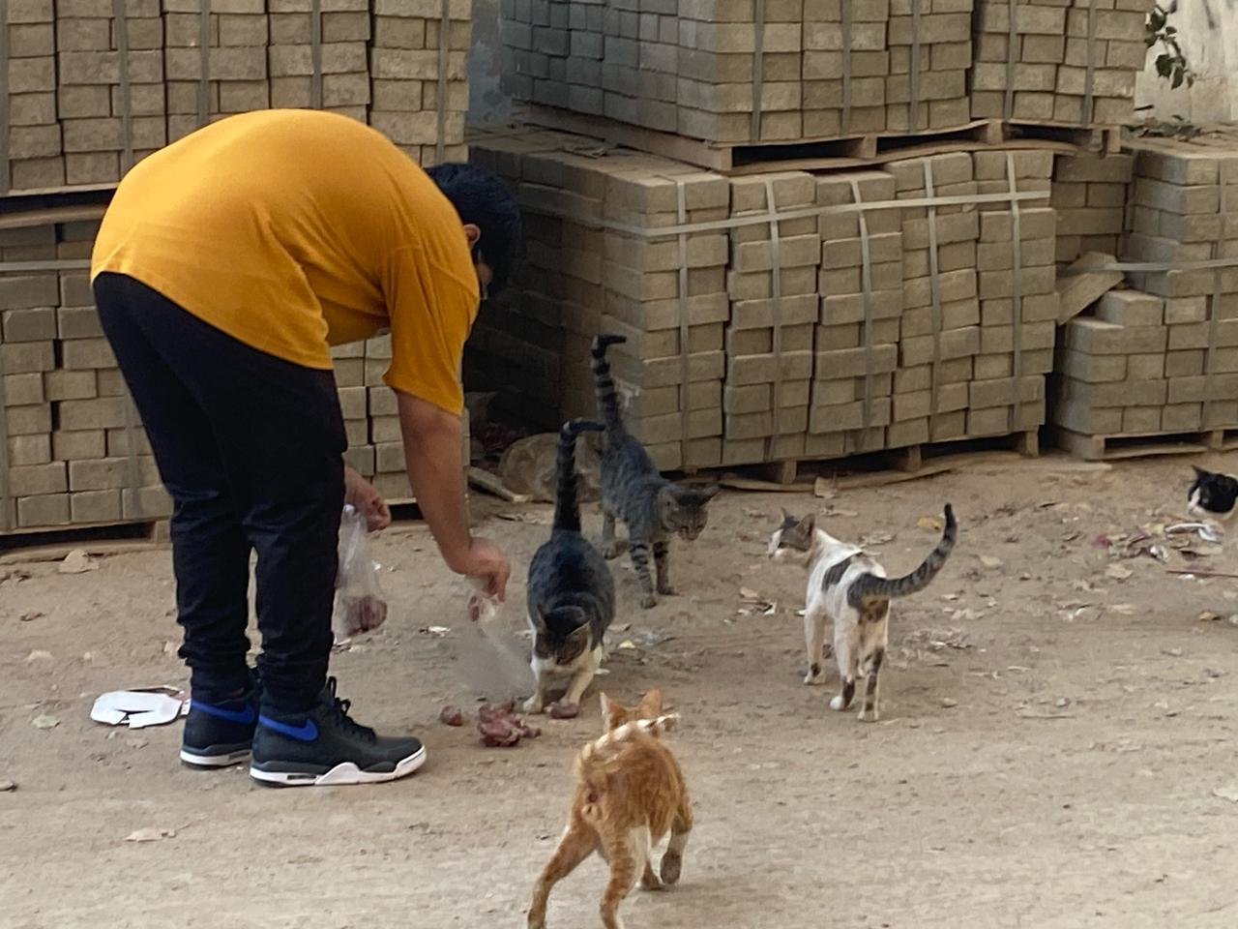
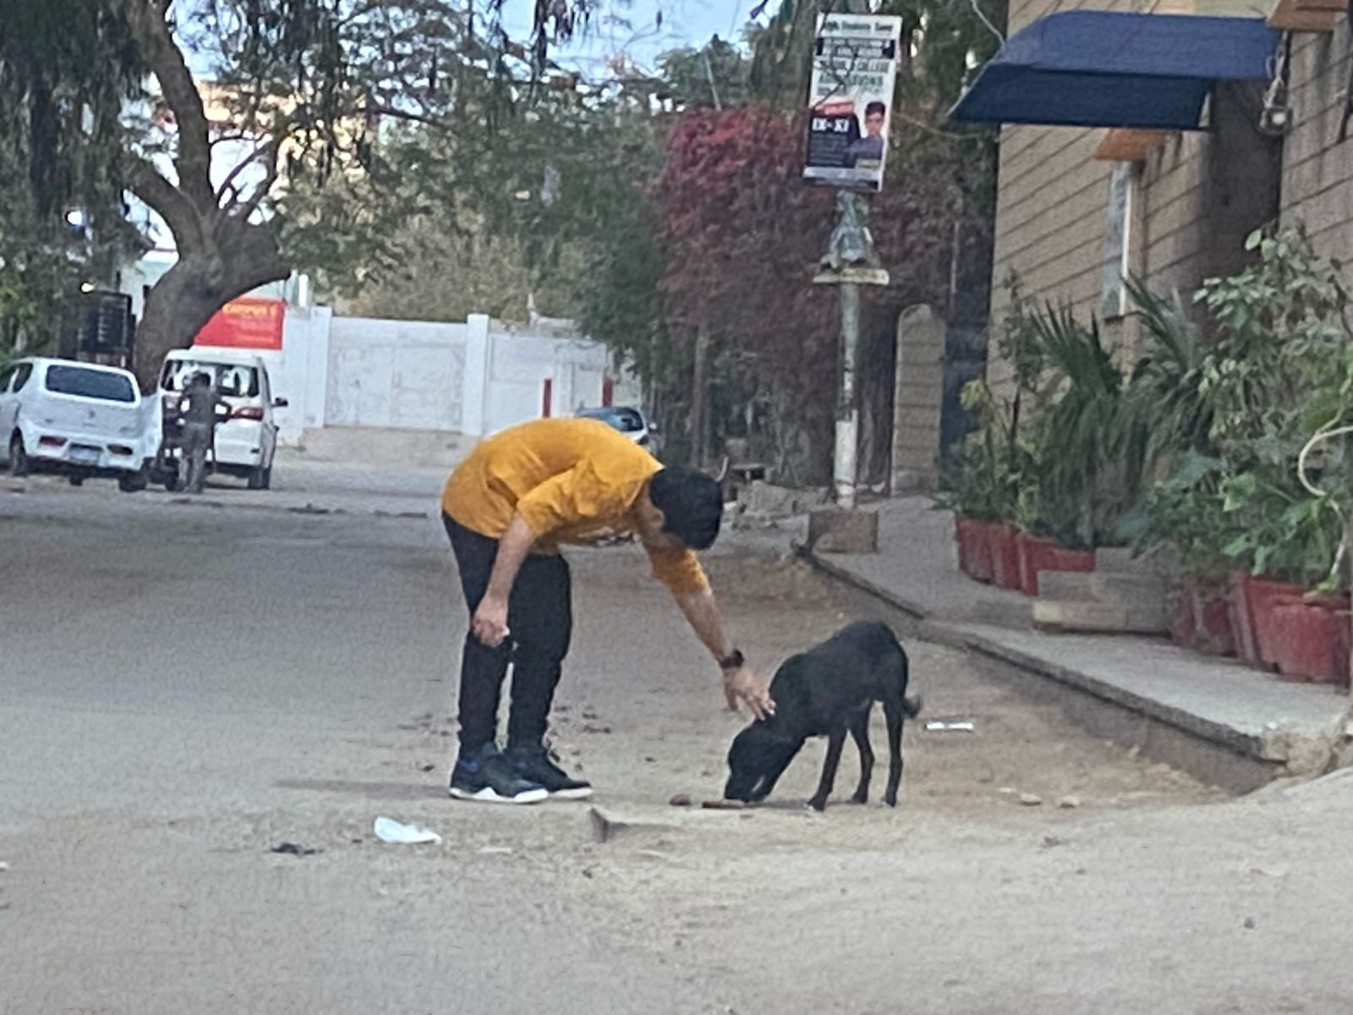
Visit Highlights
- Meeting the Stray Animals: Identified locations and engaged with community members.
- Feeding the Animals: Provided fresh food and water to strays.
- Community Engagement: Educated locals on humane treatment of animals.

Slide 5
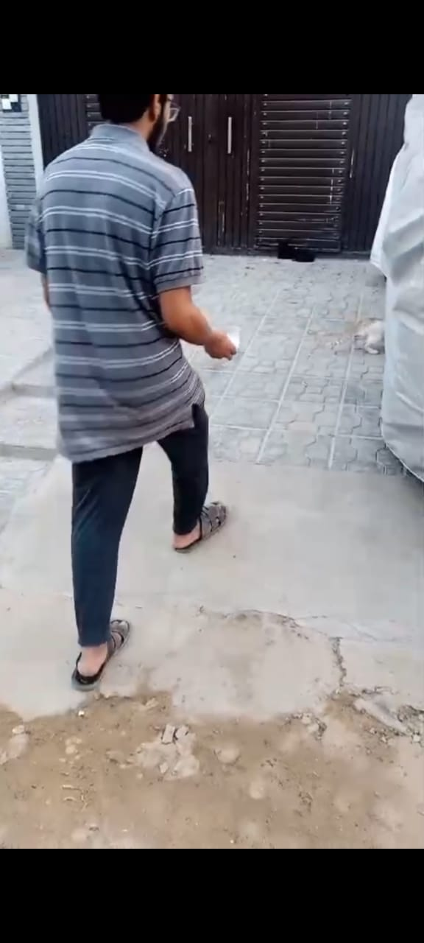
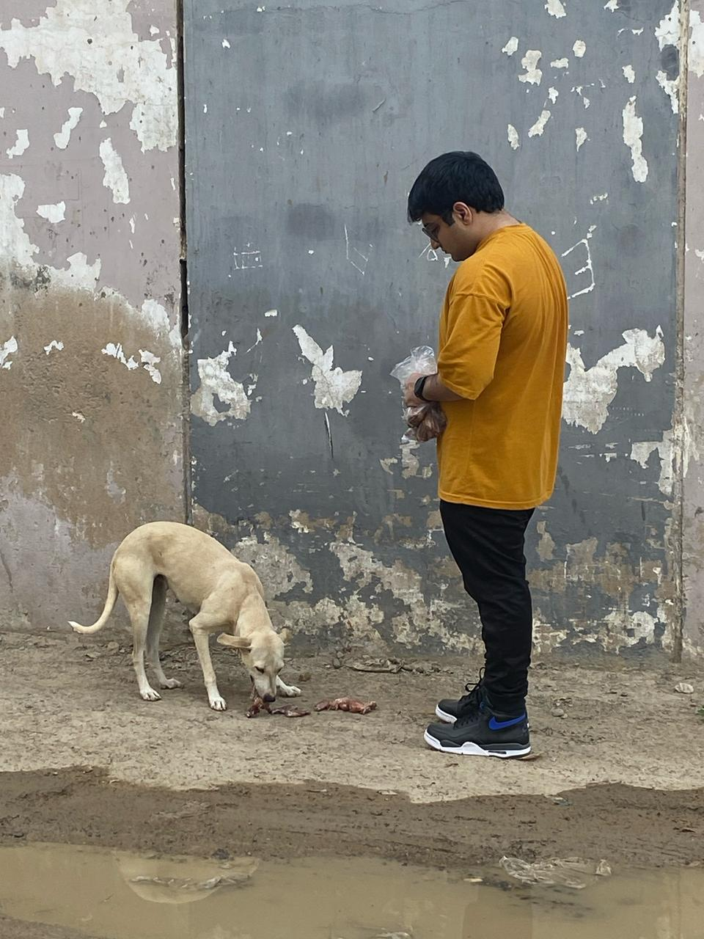
Key Takeaways
- Empathy & Responsibility: Understanding and helping stray animals.
- Sustainable Change: Encouraging long-term welfare efforts.
- Community Involvement: Importance of collective action.

Slide 6
Future Contributions
- Organizing regular feeding drives.
- Collaborating with local shelters.
- Running awareness campaigns.

Slide 7
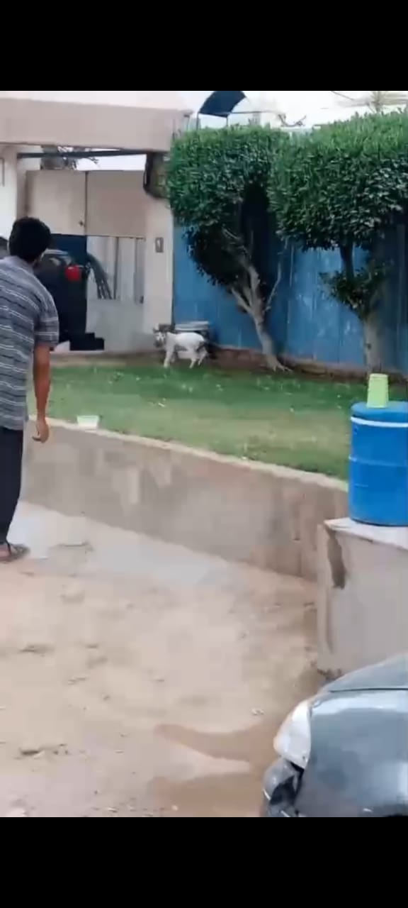
Conclusion
Our visit emphasized kindness towards animals and the impact of small actions.
We aim to continue supporting animal welfare initiatives and inspire others.
**Thank You!**

Slide 8

Thanks :3
bye

